Slide 1


Weekly Report NTUA 29/4/2020
George Bakas

Slide 2
Status Report
Analysis:
Giannis and I are trying to find bugs in codes up to signal extraction
Signal Extraction
Again we have the same problems with (1+kx)Q(x), k ↑ ↑ (2016)
Unfolding results:
Rebinning:
mJJ, ptJJ and sub-leading jetPt
With new binning we seem to have better results..
Also using the high mtt samples (2016 are ok) we get better results because we have more statistics
Global Correlation shows worse closure than Inverse matrix or L-curve methods
L-curve method and Inverse matrix have the same errors

Slide 3
Parton level MC
Simple matrix inversion
Scan L-curve method

Slide 4
Parton level MC
Simple matrix inversion
Scan L-curve method

Slide 5
Parton level MC
Simple matrix inversion
Scan L-curve method

Slide 6
Error Propagation After Unfolding

Slide 7
Error Propagation After Unfolding

Slide 8
BACKUP

Slide 9
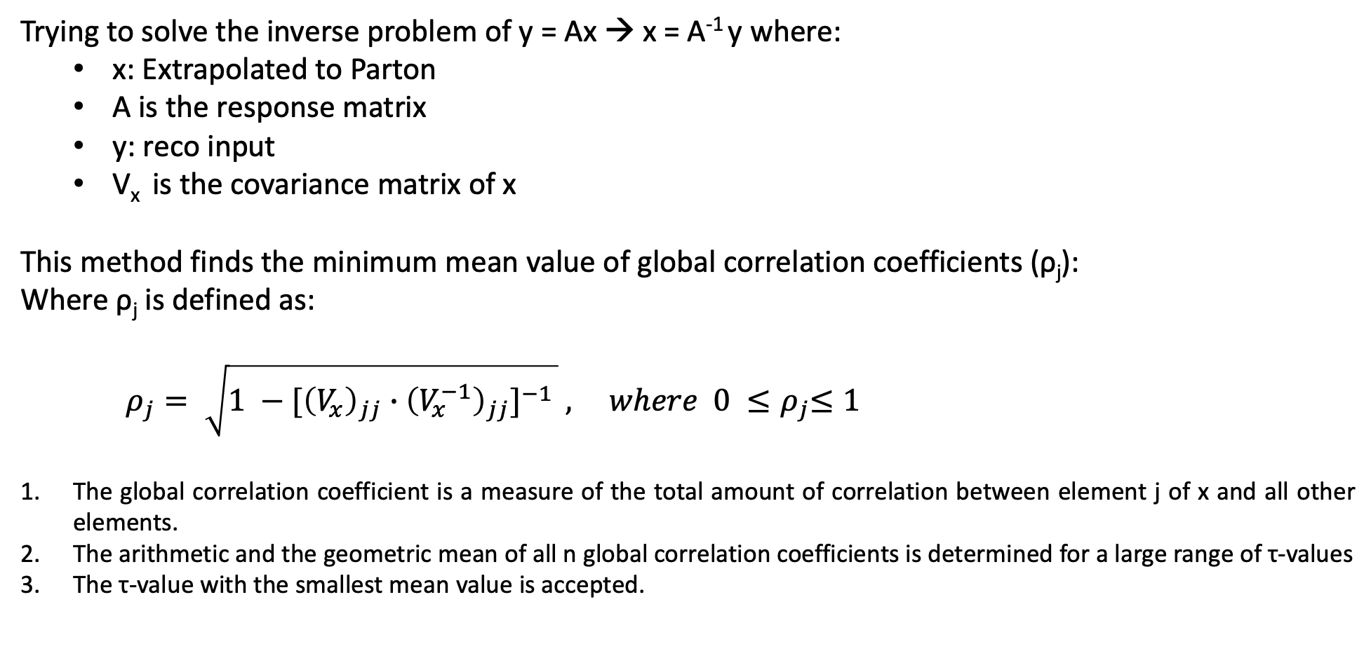
Minimum of global Correlation
Trying to solve the inverse problem of y = Ax → x = A⁻¹ y where:
x: Extrapolated to Parton
A is the response matrix
y: reco input
V_{x} is the covariance matrix of x
This method finds the minimum mean value of global correlation coefficients (ρ_{j}):
Where ρ_{j} is defined as:
$ρ_{j}= \sqrt{1 −{[\left(V_{x}\right)}_{jj} ∙{\left(V_{x}^{−1}\right)}_{jj}]^{−1 }} , where 0 {≤ρ}_{j}≤1$
The global correlation coefficient is a measure of the total amount of correlation between element j of x and all other elements.
The arithmetic and the geometric mean of all n global correlation coefficients is determined for a large range of τ-values
The τ-value with the smallest mean value is accepted.

